Slide 1
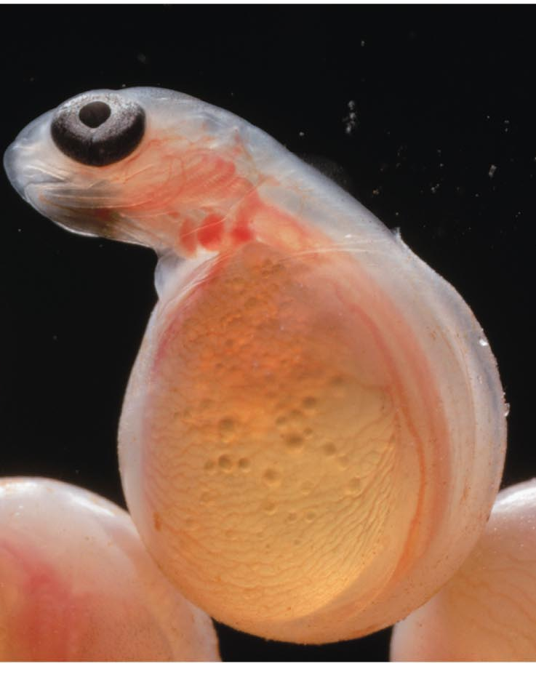
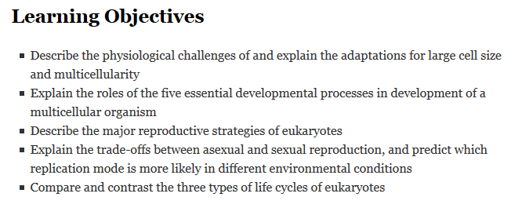
Introduction to Growth and Reproduction
Differentiation in growth
Modes of reproduction
Diversity of life cycles

Slide 2
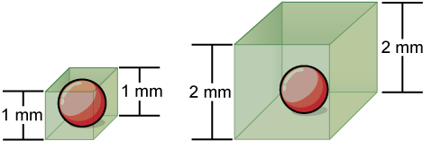
Biologically, what’s so bad about this scenario?
Notice that as a cell increases in size, its surface area-to-volume ratio decreases. The cell on the left has a volume of 1 mm³ and a surface area of 6 mm², with a surface area-to-volume ratio of 6 to 1, whereas the cell on the right has a volume of 8 mm³ and a surface area of 24 mm², with a surface area-to-volume ratio of 3 to 1.
Notes:
3mm sides:
Volume = 27 mm3
SA = 54 mm2
SA-to-Vol ratio = 2 to 1

Slide 3
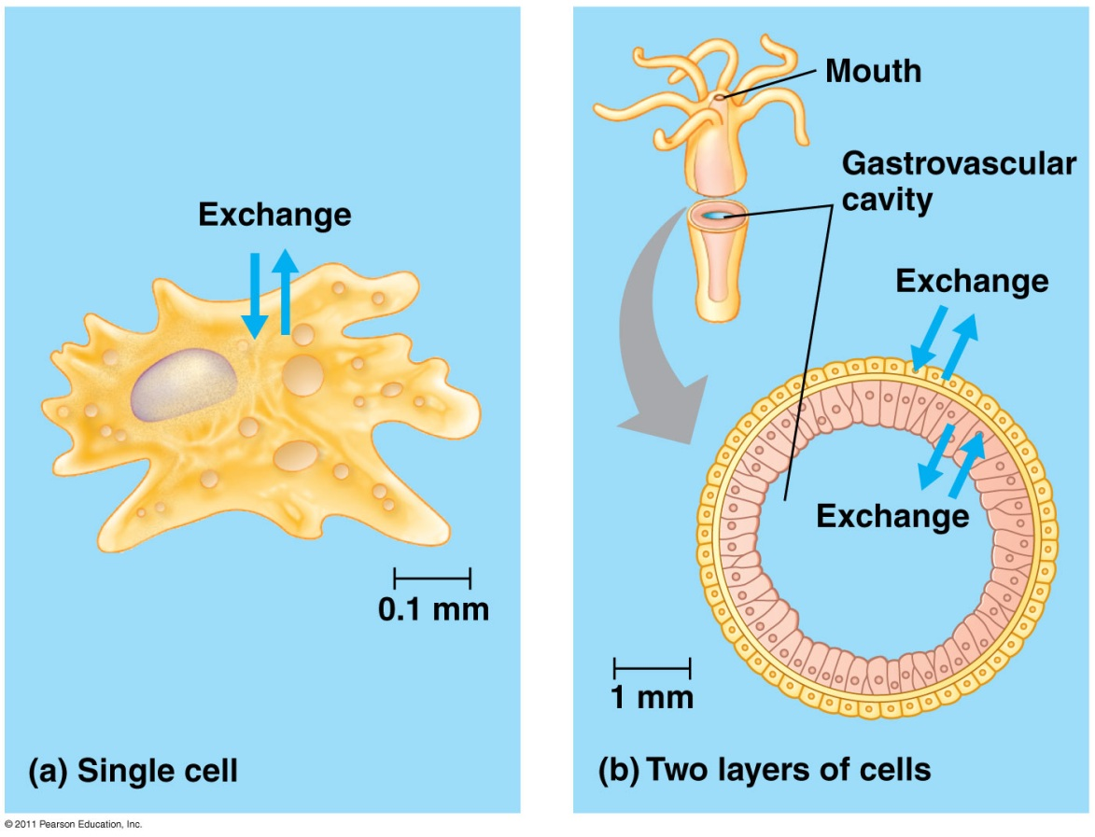
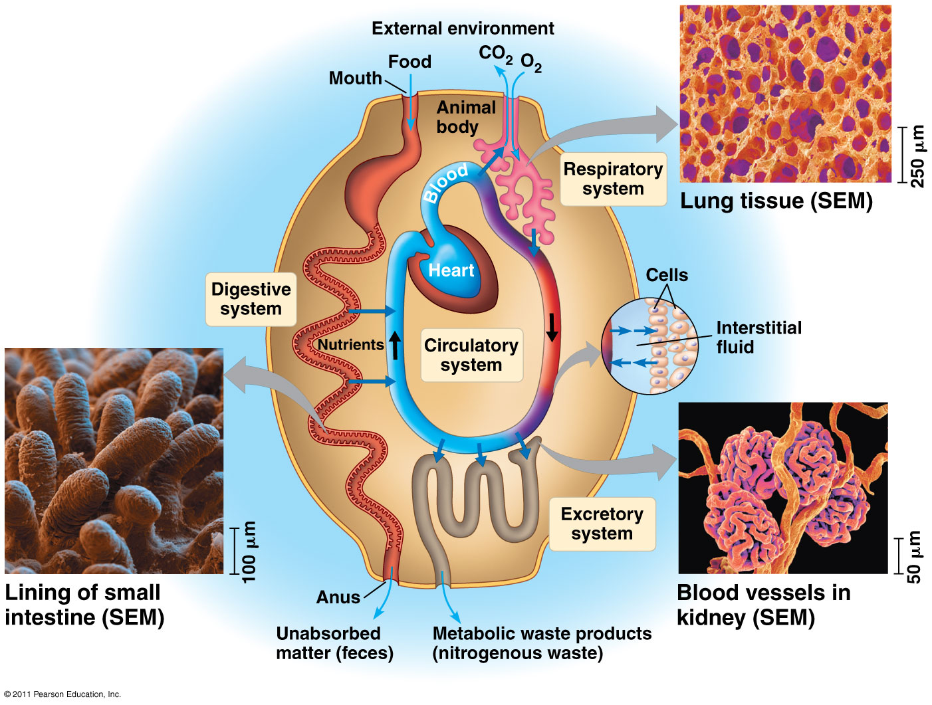
Multicellularity, cell differentiation, and tissues

Slide 4
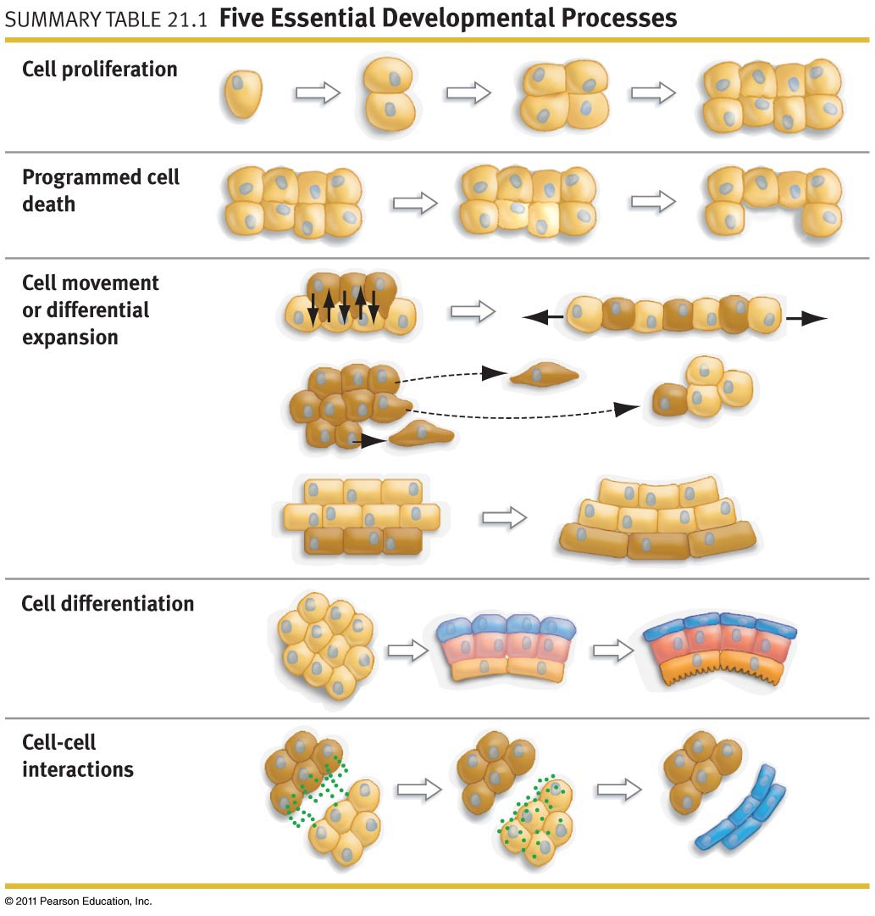
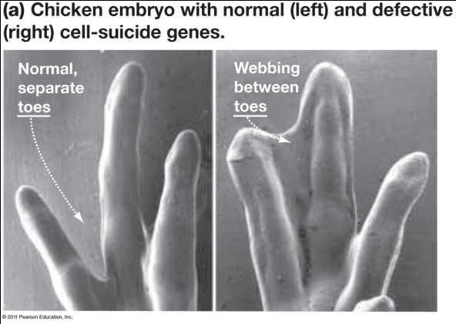
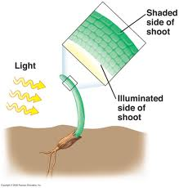
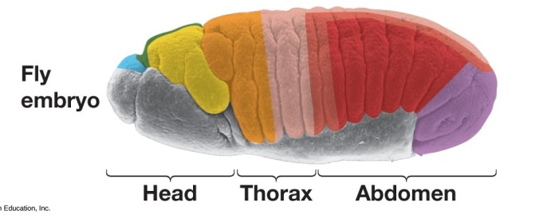
Animal cells move
Plant cells differentially expand
(induction)
Notes:
Key problem: growth and dev must be REGULATED
Regulation = CHANGES IN GENE EXPRESSION

Slide 5
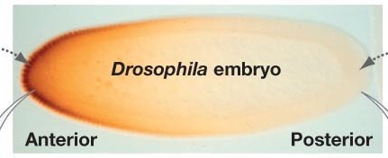
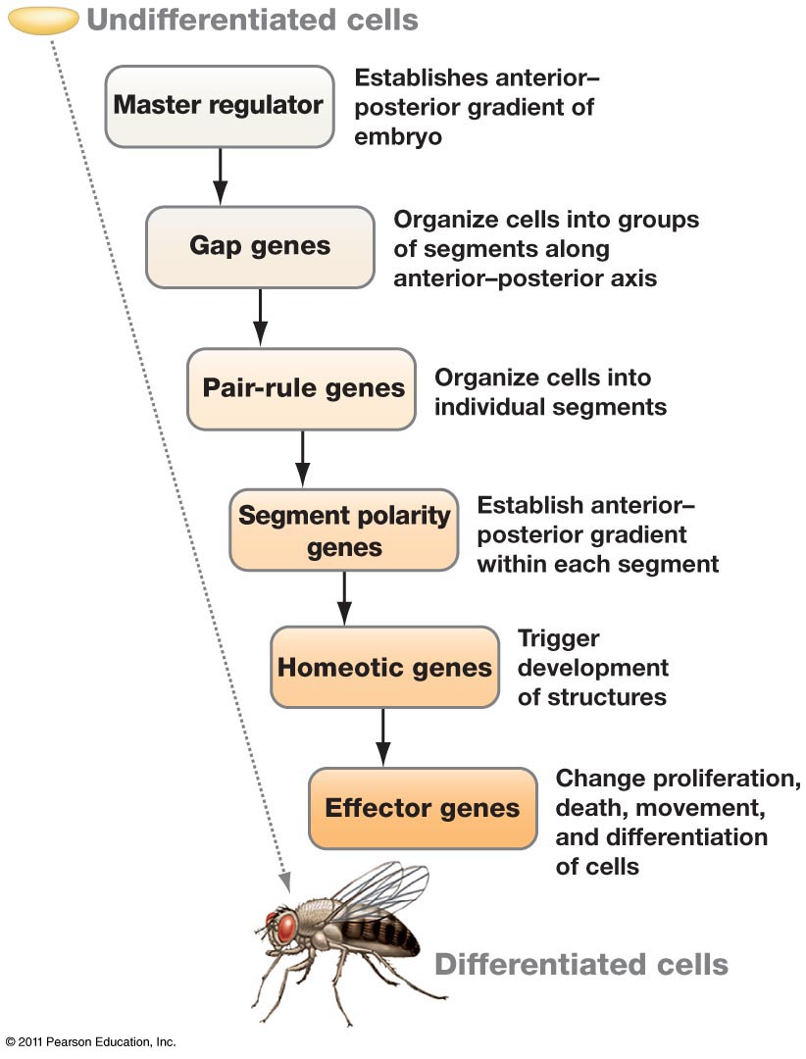
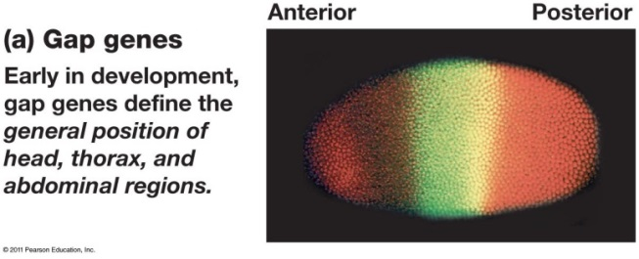
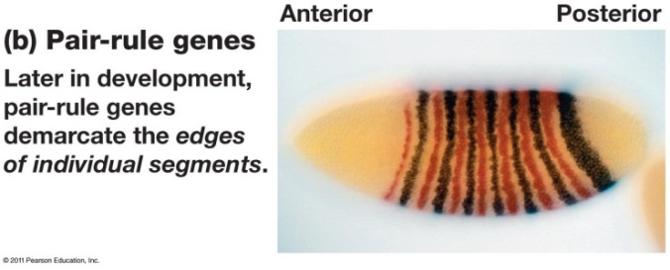
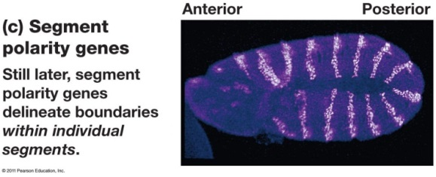
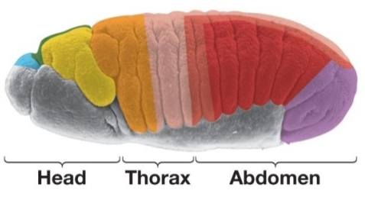
Morphogenesis & differential gene expression
Morphogens:
bicoid, nanos
Genes activated as result:
knirps, Krüppel, hunchback
Genes activated as result:
even-skipped,
odd-skipped,
hairy, paired, runt
Genes activated as result:
Engrailed, gooseberry
Genes activated as result:
antennapedia, ultrabithorax
In each image above, the colors represent different genes that are turned on in different cells or locations in the developing embryo
Freeman 21.6-9
Notes:
Morphogen = anything present with concentration gradient; cells detect location within embryo based on local concentration

Slide 6


Cell differentiation
The process:
The reason it happens:
Single Cell
mitosis
induction
Expression of skin cell specific genes
Expression of muscle cell specific genes
Skin Cell
Muscle Cell

Slide 7
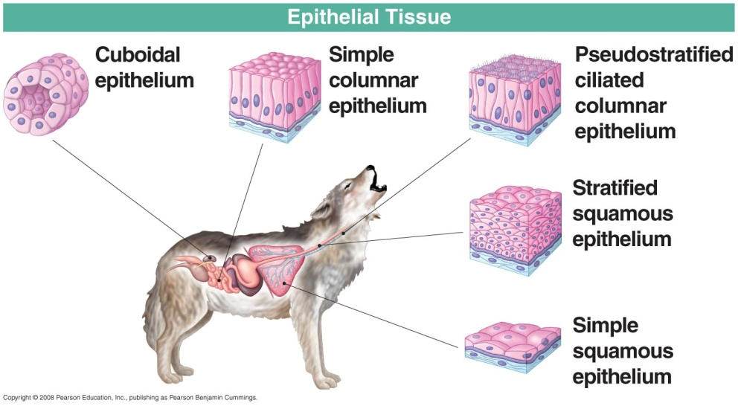
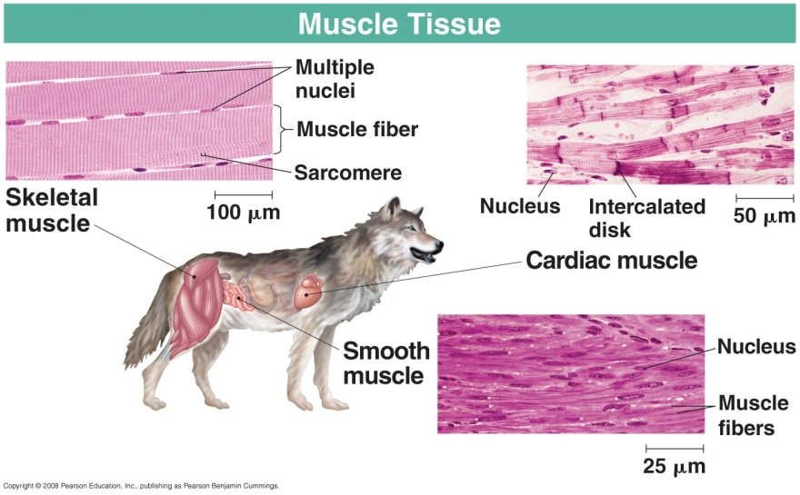
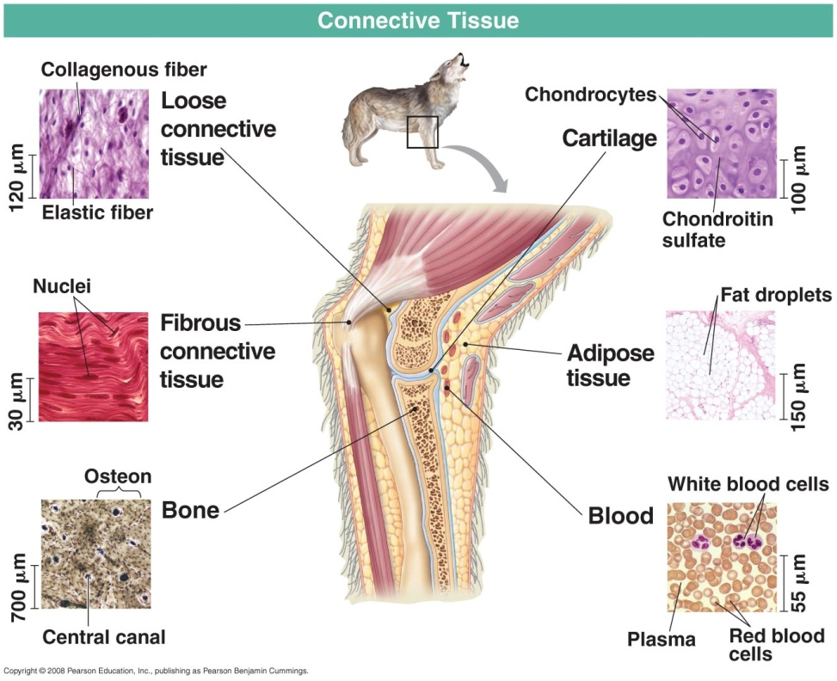
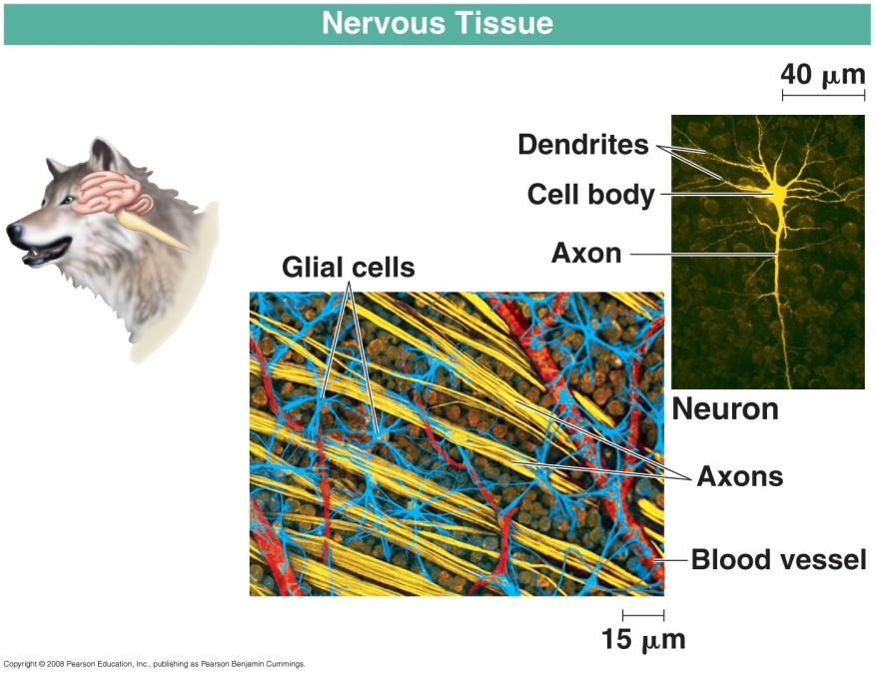
Differentiation of animal tissue

Slide 8
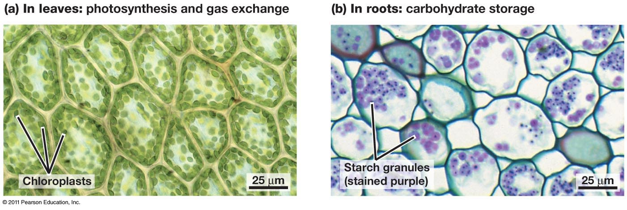
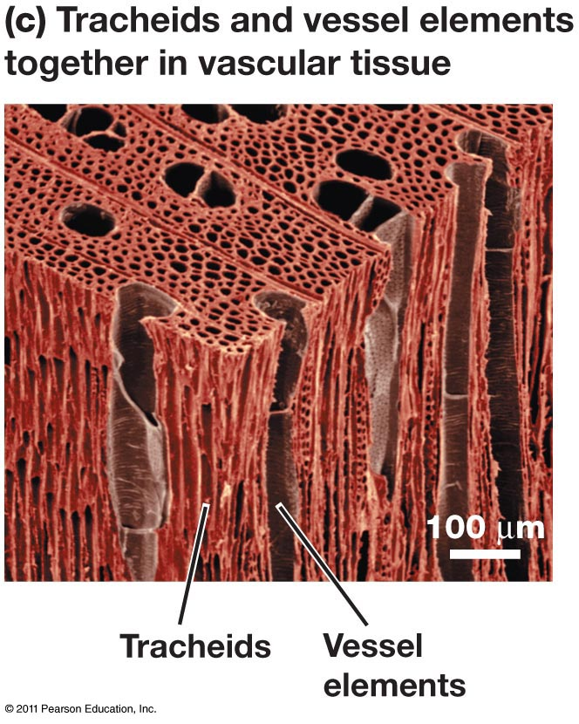
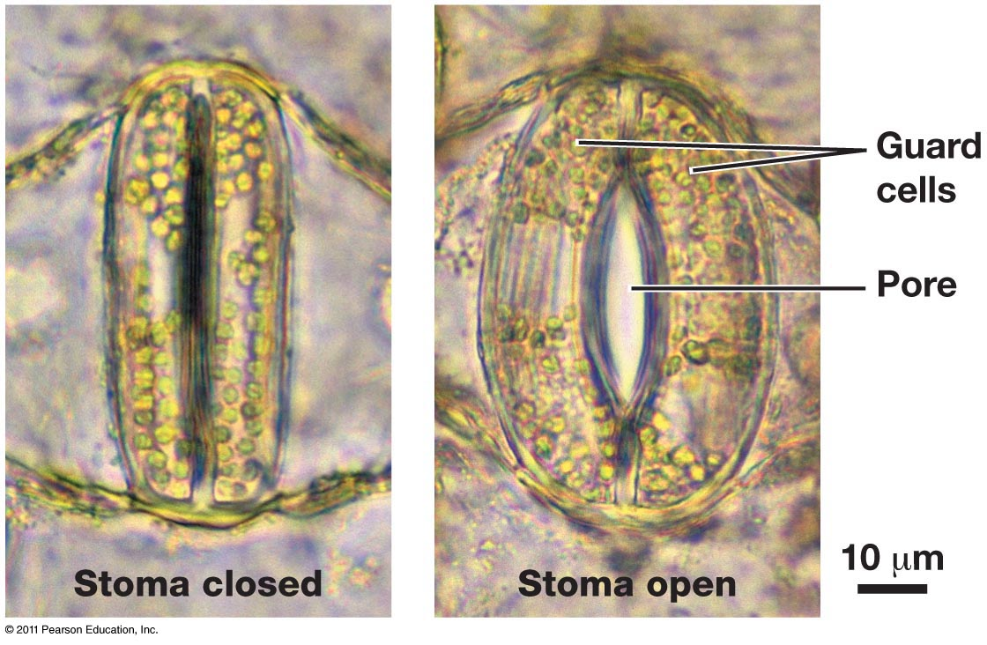
Differentiation of plant tissue
Ground tissue (parenchyma)
Dermal tissue
Vascular tissue
(xylem)
Freeman 36.18-24

Slide 9
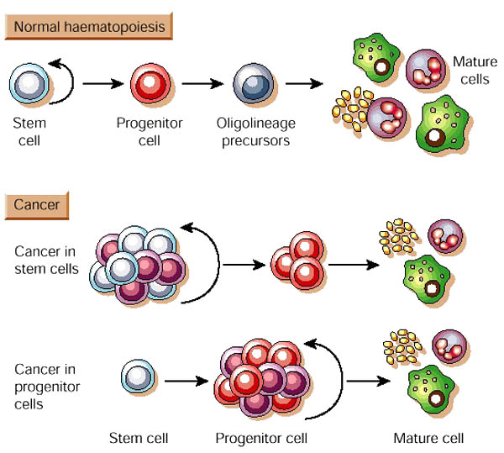
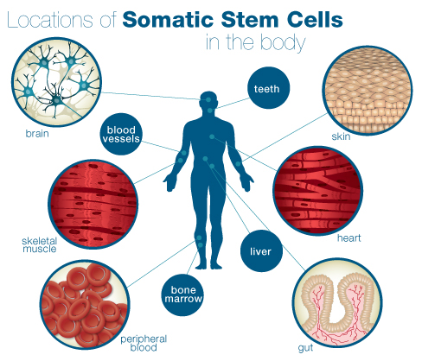
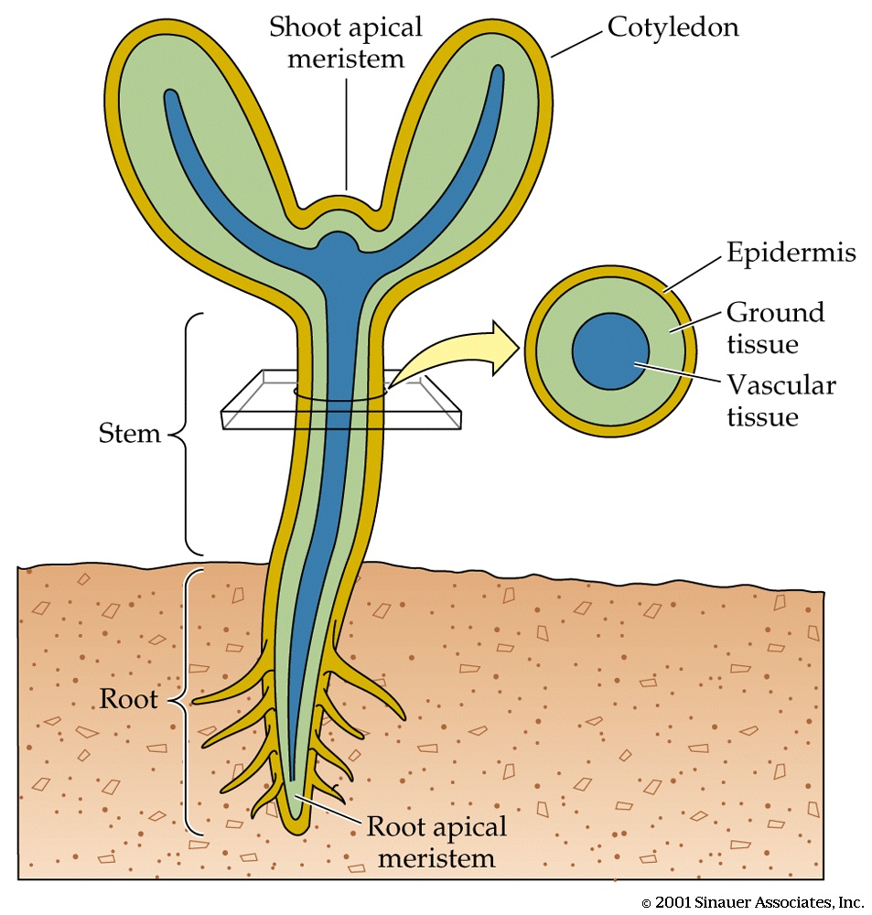
Determinate versus indeterminate growth
Determinate growth stops at some point - leaves, flowers, fruits, most animals
Indeterminate growth produces new cells indefinitely – meristems (plants), stem cells (arguably; animals)
Forever Young
Forever Young

Slide 10
asexual vs sexual reproduction
Type of reproduction | Relatedness btwn parent and offspring | Benefits | Costs
Asexual
Sexual
Notes:
Many seedless plants , gymnosperms, and angiosperms can reproduce both asexually and sexually.
If reproducing asexually, an organism passes all of its genes to its offspring, if sexually only 1/2 of its genes are passed on. Sexual reproduction uses lots of energy and resources. Asexual reproduction is generally a simpler, less hazardous means of plant propagation. Each mode has its advantages.
In stable environments asexual reproduction can make many copies of an individual, well adapted to a particular environment, for a low reproductive energy cost. Survival of offspring are higher because most offspring are initially not as frail as seedlings. The offspring are usually fragments of mature vegetative plants (called vegetative reproduction). Sometimes a clone is so efficient that it covers an area so thoroughly that it prohibits other species or seeds from the same species from growing in the same area. But if the environment changes, these cannot adapt. In my research there is a lot of discussion on how many clones are needed for an area to avoid risk of environmental pressures.
In unstable environments where change environmental pressures like evolving pathogens, occur, sexual reproduction provides new genetic combinations that may be able to survive in the new environment.

Slide 11
asexual vs sexual reproduction
Type of reproduction | Relatedness btwn parent and offspring | Benefits | Costs
Asexual (favored in constant environments) | 100% | Fast All offspring adapted to current conditions No searching for partner Hi population growth Everybody is a parent | Limited genetic diversity Environment can change Gender imbalance?
Sexual (favored in variable environments) | 50% | Genetic recombination Mutations balanced by non-mutated copies If environment changes, some offspring will have the “right” genes | Slower “Good” gene combo of parents not matched in offspring Only females make babies (gender balance?) Lo population growth
Notes:
Many seedless plants , gymnosperms, and angiosperms can reproduce both asexually and sexually.
If reproducing asexually, an organism passes all of its genes to its offspring, if sexually only 1/2 of its genes are passed on. Sexual reproduction uses lots of energy and resources. Asexual reproduction is generally a simpler, less hazardous means of plant propagation. Each mode has its advantages.
In stable environments asexual reproduction can make many copies of an individual, well adapted to a particular environment, for a low reproductive energy cost. Survival of offspring are higher because most offspring are initially not as frail as seedlings. The offspring are usually fragments of mature vegetative plants (called vegetative reproduction). Sometimes a clone is so efficient that it covers an area so thoroughly that it prohibits other species or seeds from the same species from growing in the same area. But if the environment changes, these cannot adapt. In my research there is a lot of discussion on how many clones are needed for an area to avoid risk of environmental pressures.
In unstable environments where change environmental pressures like evolving pathogens, occur, sexual reproduction provides new genetic combinations that may be able to survive in the new environment.

Slide 12
Types of asexual reproduction
Binary fission – splitting in two equal halves
Multiple fission – splitting into more than 2 cells
Budding – outgrowth of a new cell from and old cell/new organism from old organism
Fragmentation – mature organism splits into fragments capable of forming new organisms
Spores – specialized cells capable of forming a new organism; usually haploid and produced by meiosis
Parthenogenesis – development of unfertilized egg into new organism
Polyembryony – fertilized egg splits to form genetically identical clones
Vegetative growth – growth of new organism from meristematic cells without spores or gametes

Slide 13
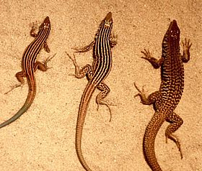
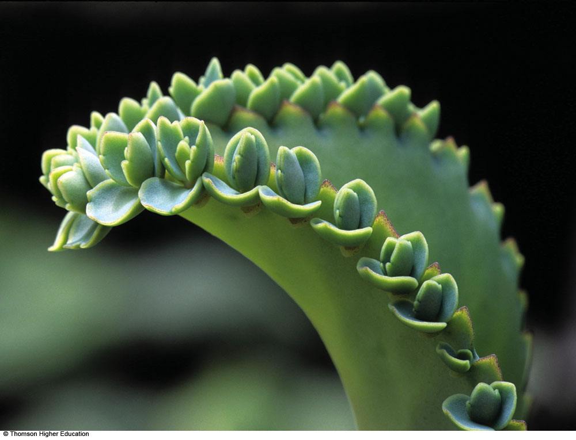
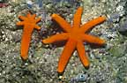
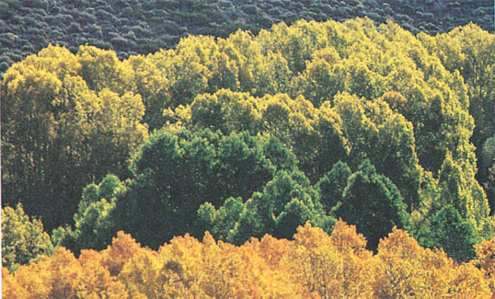
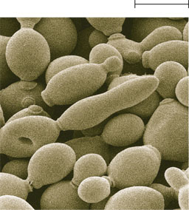
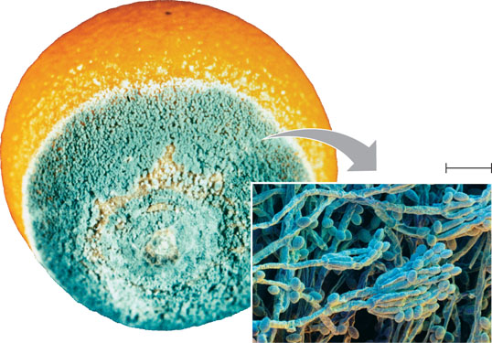
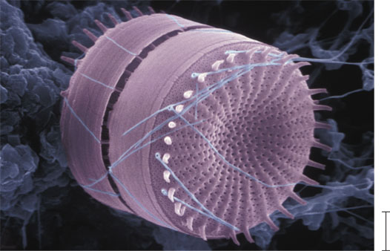
Fungi
Binary fission
Multiple
Budding
Spores
Fragmentation
Some molds and yeasts have no known sexual stage. Mycologists have traditionally called these deuteromycetes, or imperfect fungi
Animals
Budding
Parthenogenesis
Polyembryony
Fragmentation
Plants
Spores
Fragmentation
Vegetative growth
Parthenogenesis
Polyembryony
^{10 m}
^{Parent cell}
^{Bud}
Microbial eukaryotes
Binary
Multiple
Budding
^{Bud}

Slide 14
Sexual Reproduction
Sexual reproduction: the offspring are not identical to the parents.
What is the ploidy of gametes?
Why is this reproductive strategy evolutionarily important?
Sexual reproduction in animals consists of three fundamental steps:
Making gametes: gametogenesis
Getting gametes together: mating
Fusing gametes: fertilization
Organisms accomplish these three steps in different ways and at different times (a change in ploidy is always required):
Diplontic life cycle
Haplontic life cycle
Alternation of generations

Slide 15
Sexual reproduction always requires meiosis (a reduction in ploidy)
Mitosis makes more identical cells (growth of a multicellular organism
Meiosis reduces the amount of genetic material (the number of alleles) by half
Gametes are always haploid (half the amount of genetic material as the mature, multicellular organism)
Fusion of gametes doubles the ploidy
See the bio1510 web site page on Cell Division for more help on these concepts

Slide 16
Gametes vs Spores
Gametes and spores always haploid
Gametes are units of sexual reproduction: must fuse with another gamete
Spores are units of asexual reproduction: often used to disperse into a new environment where they grow into mature multicellular organisms

Slide 17
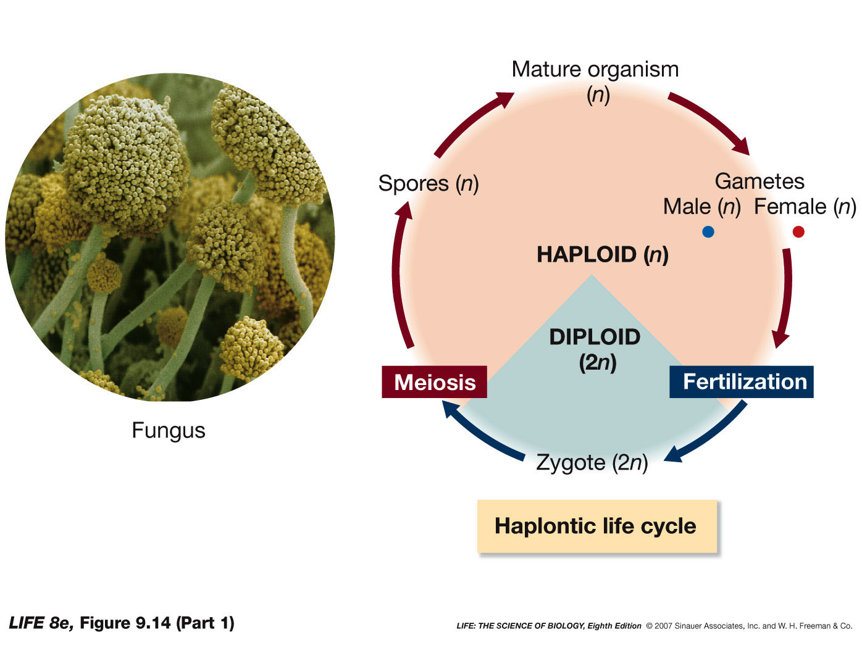
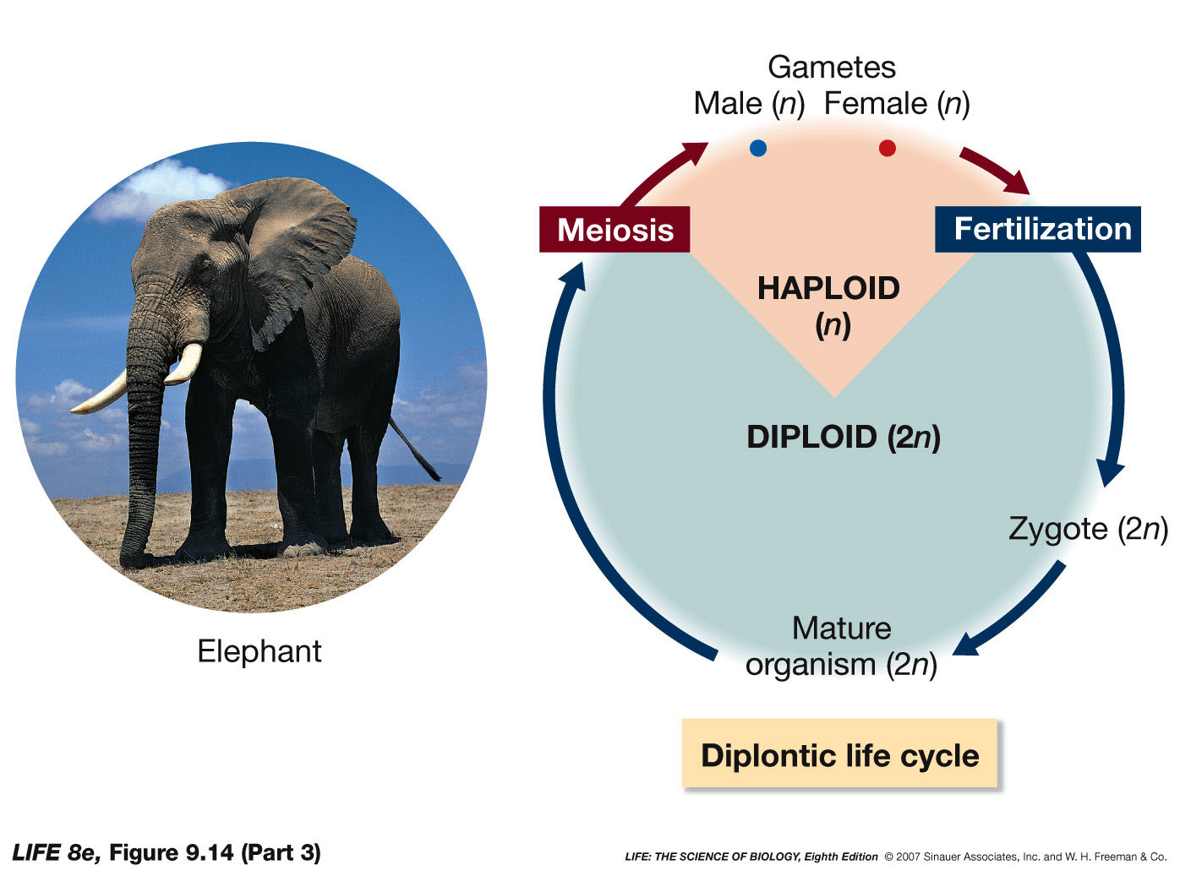
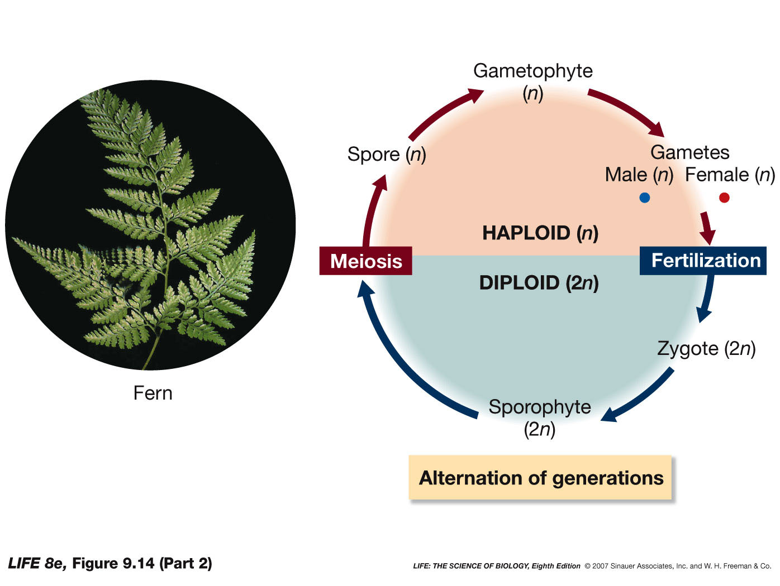
For each life cycle:
What is the ploidy of the mature, multicellular organism?
What type of cell division produces spores?
What type of cell division produces gametes?
What process produces the zygote?

